Slide 1


Body Mass Index calculator
Deploying Machine Learning Model that many can use to find out their Body Mass Index
Presenter: Mattithyahu Owolabi

Slide 2
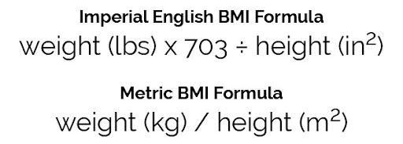
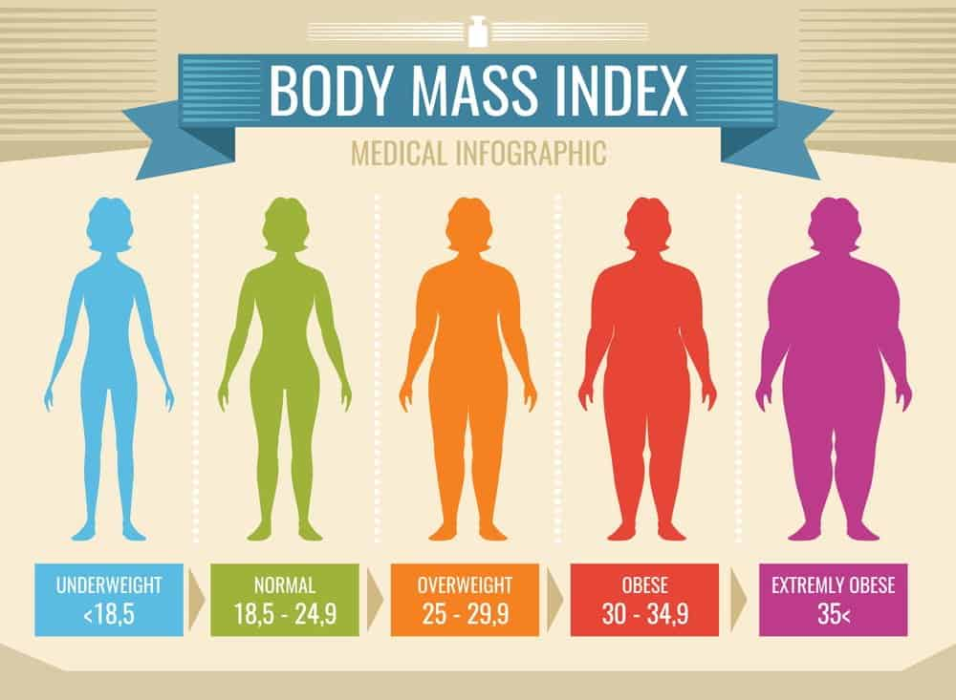
Project Overview
What is BMI?
Index classification equation used to give insight on an individuals obesity.
The most widely used method to check if you're a healthy weight is body mass index (BMI).
Why is it Important?
The majority of adults were overweight or obese; 67% of men and 60% of women.
– Source NHS UK

Slide 3


BMI and Data Science
How to use this data and Machine learning?
Using predictive capabilities of Machine Learning to train a model on BMI data, optimise to improve the performance and then deploying it into production
How to use this data and Machine learning?
Using predictive capabilities of Machine Learning to train a model on BMI data, optimise to improve the performance and then deploying it into production

Slide 4
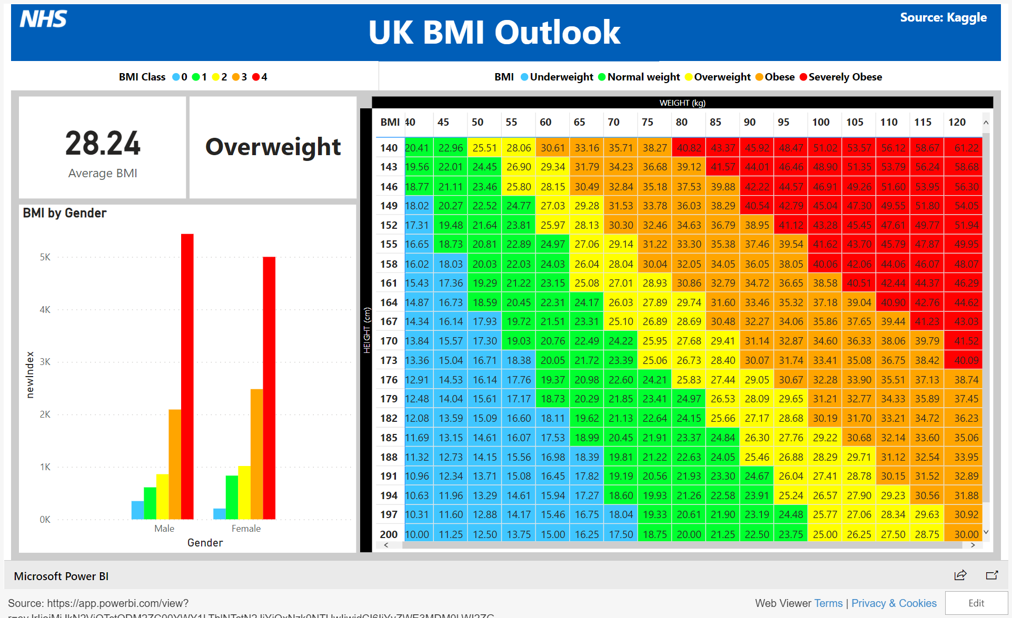
Dashboard

Slide 5
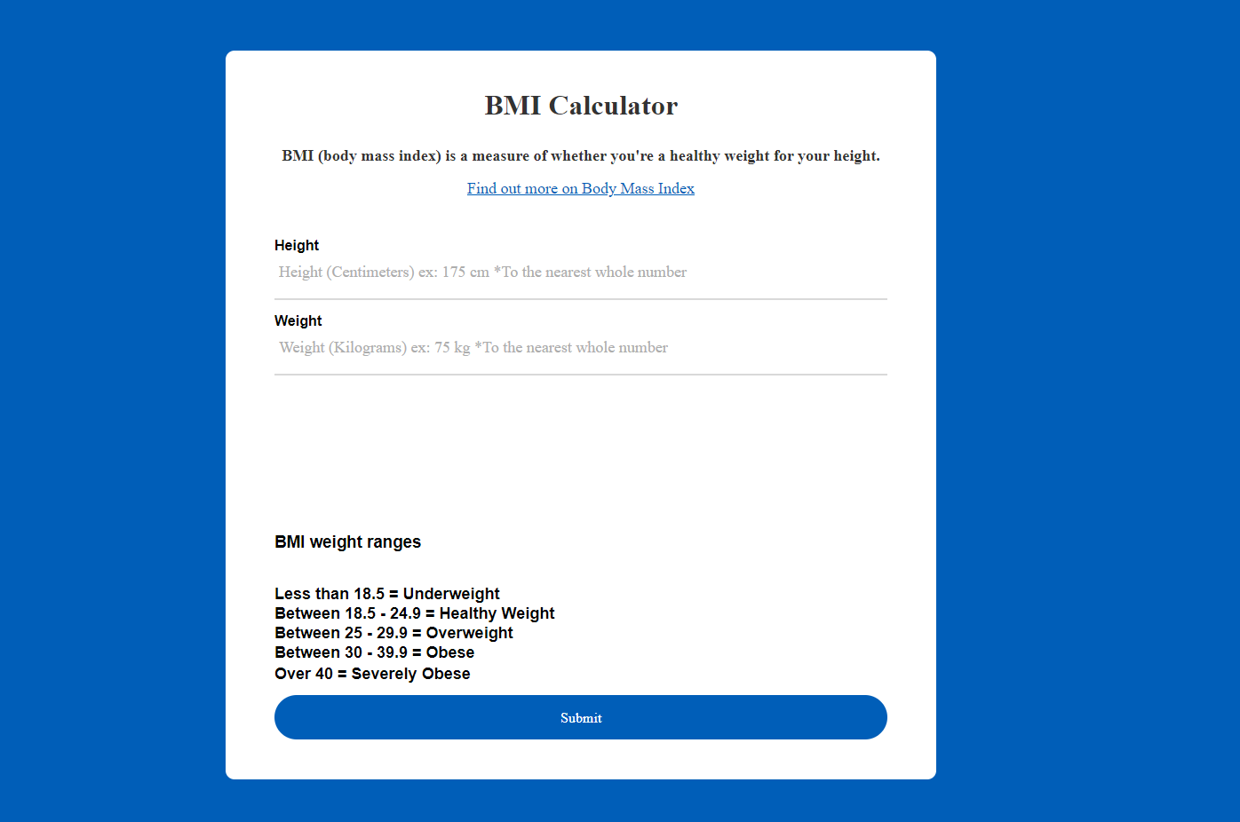
Deployment

Slide 6

Evaluation
Finally and optionally, talk about future work.
What are the next steps?
Does the problem need to be revisited in the future?
Can the project be improved with more work?
If you were given more time and resources, is there anything that could be done better?

Slide 7
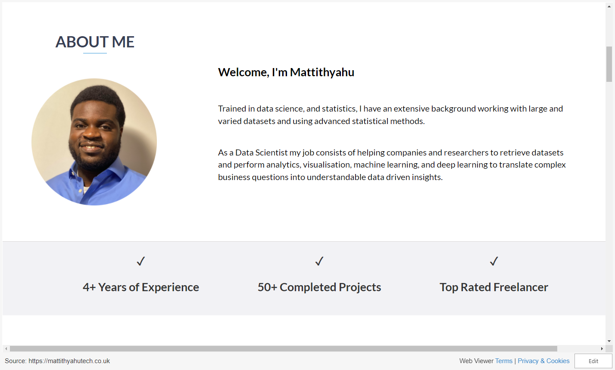

Slide 8
Conclusion
Thanks for listening
Questions?

